Slide 1
Alien Pig invaders
Doug Blase, Nick Contini

Slide 2
Basic Premise
You are a low-flying UFO being chased by many robotic pigs.
You are trying to reach the end of the maze without being touched by a pig.

Slide 3
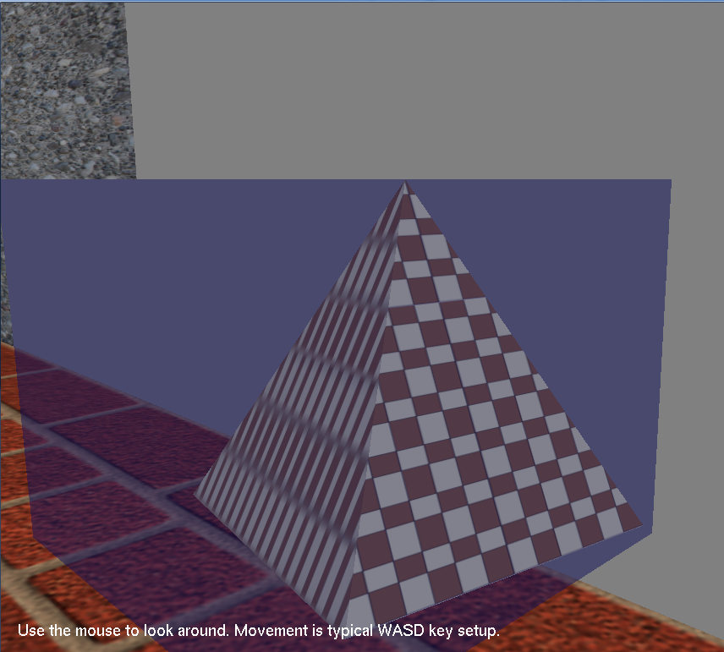
Basic Instructions
This is the trinket you are searching for.

Slide 4
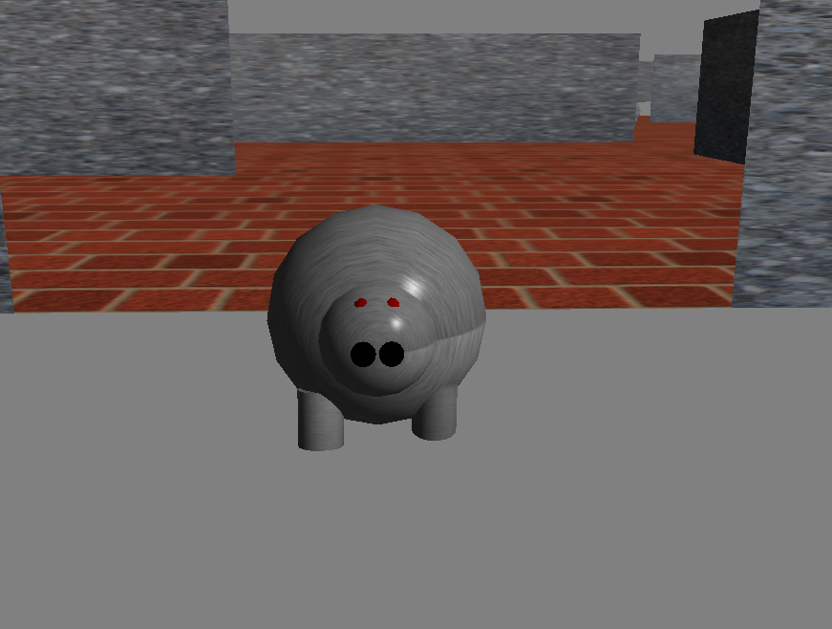
GAME OVER
Don’t let the pigs touch you, or the game is over!

Slide 5
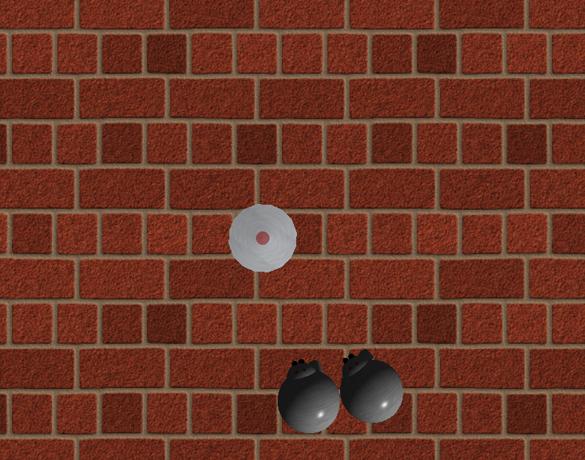
Viewpoints
There are two camera angles you can use, selectable by right-clicking at any time from within the game: Overhead, and first person. Instructions for moving are always displayed on the screen.

Slide 6
Implementation
The floor and walls are separate variations of the Wall class provided in the base library we have been using all semester.
We use a vector of walls and pigs to make up the maze
Collision detection with walls was made possible through the getWorldPosition method of VisualObject. When an object was close enough to the wall, we restricted movement in the direction that would take them through the wall.

Slide 7
Problems encountered
Having multiple pigs made the pig sounds annoying to the user. We fixed this by using update() to only let the pigs within proximity make noises. The rest of the pigs are silent.
Wall collisions on the corners/edges of the wall were difficult as well. We had to be careful with our calculations in those scenarios. There were also two ways to calculate movement based on the view, so the collision calculation had to be generalized in order for it to work for both viewpoints.
The sphere object had to be altered to make transparent (unfortunately you can’t tell it’s transparent…)
A lot of trigonometry was required in order to make the tilt animation for the UFO and the view points work properly.
Had to become familiar with the KeyboardUpFunc in order to implement better movement control.

